Slide 1

Auto-Insurance Fraud Dataset Group - 9
ROLL NUMBER | NAME
P2522001 | ADITYA MAHENDRA NATHANI
P2522009 | ANUSHA AGARWAL
P2522030 | KARTHIK RAJA
P2522032 | KRISH SHARAN
P2522036 | M PRAVEEN KUMAR
Notes:
Image source: Microsoft 365 content library This dataset features 1,000 rows, each representing a unique customer and incident report, with 39 columns detailing policy, demographic, and claim information. Key data includes policy/customer details, incident specifics, claims, vehicle data, and a fraud label. The primary focus is to detect fraudulent activity in auto-insurance claims, linking all relevant information per case.

Slide 2
Data Structure
Rows & Columns: The dataset has 1000 rows (each representing a unique insurance policy holder and incident report) and 39 columns.
Nature of Data:
Policy & Customer Information: policy number, bind date, premiums, deductibles, umbrella limit.
Customer Profile: demographics, occupation, education, hobbies.
Incident Details: incident type, date, severity, authorities contacted, etc.
Claims Data: injury, property, vehicle, total claim amounts.
Vehicle Information: make, model, year.
Fraud Label: binary target variable.
Business Understanding: This dataset is essentially fraud detection in auto-insurance claims. Each row links the customer, their policy, details of an accident/incident, the associated claims, and whether fraud was flagged or not.

Slide 3
Business Context & Key Business Questions
Context: Insurance companies face significant financial losses due to fraudulent claims. BI dashboards can help stakeholders monitor claims, detect patterns in fraud, and optimize premiums/deductibles.
Key Business Questions:
What customer profiles, policy types, and incident characteristics are most indicative of fraudulent claims?
Where are the geographic or time-based bottlenecks in the claims process, and how can we reduce claim cycle time and costs (e.g., analyzing incident city and incident hour of the day)?
Are people with higher education levels less likely to report insurance fraud?
Do claim amounts (injury, property, vehicle) correlate with higher fraud likelihood?

Slide 4
Metrics & Dimensions
Metrics (Quantitative KPIs)
Total Claims = Number of claims
Fraudulent Claims = Number of fake claims
Fraud Rate (%) = (# Fraudulent Claims ÷ Total Claims) × 100
Total & Avg. Claim Amounts (Injury, Property, Vehicle, Total)
Dimensions (Qualitative)
Customer Profiles: Age, Gender, Education Level, Occupation
Incident Characteristics: Type, Severity, Hour of Day
Geographic/Time: Incident State, Incident City, Hour of Incident
Fraud Label: Fraud reported (Y/N, the key classification target)

Slide 5
Insights
Geographic Risk: The map visualization indicates clusters of claims in the Northeastern United States (e.g., near New York, Philadelphia, Toronto, Ottawa).
Fraudulent Claims are Inflated: Fraudulent claims (Y) have significantly higher average claim payouts across all categories compared to non-fraudulent claims (N).
Vehicle Claim: The average for fraudulent claims ($43,533.64)
Property Claim: The average for fraudulent claims ($8,560.12)
Injury Claim: The average for fraudulent claims ($8,208.34)
Claimant with an Executive/Managerial occupation (≈38% fraud rate).
Low-Risk Hours: The lowest fraud rate occurs at 9 AM (9.30%).
Major Damage (over 60% fraud rate).
An Incident Hour of 11 AM, 2 PM, or 6 PM (up to 40% fraud rate).

Slide 6
Recommendations
Immediately flag and assign all claims falling into the top-risk categories to an experienced Special Investigation Unit (SIU) team for immediate, in-depth review.
Staff adjusters and external vendors (e.g., tow companies, inspectors) to have faster response times and higher availability during the peak fraud hours (11AM, 2PM, 6PM) as quick verification can often deter staged or exaggerated claims.

Slide 7
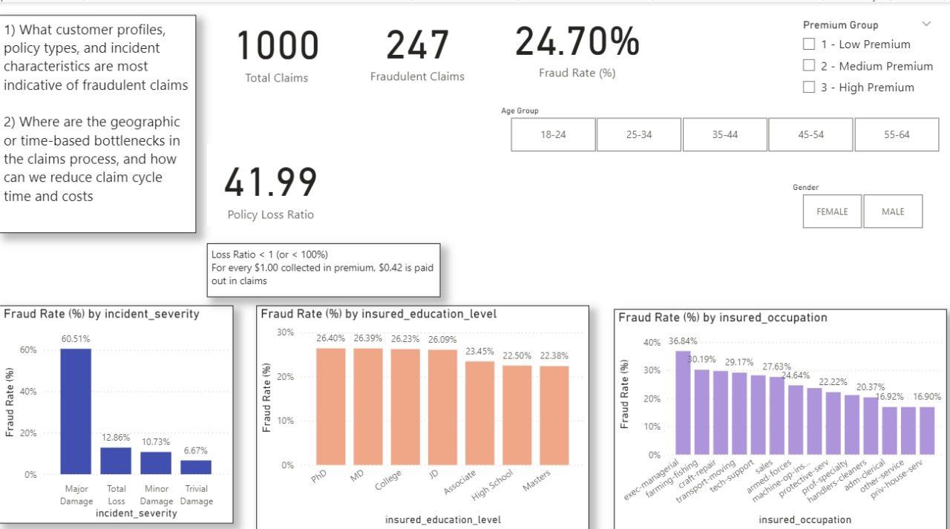
Fraud Analytics Layout (for Leadership)

Slide 8
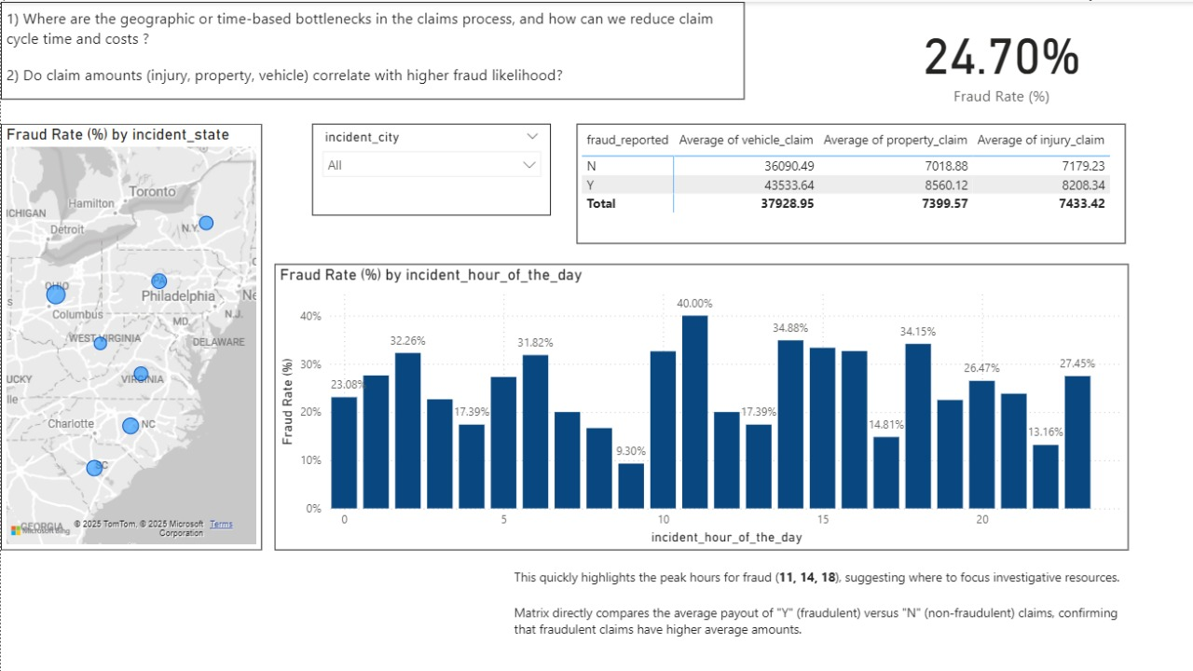

Slide 9
